Slide 1
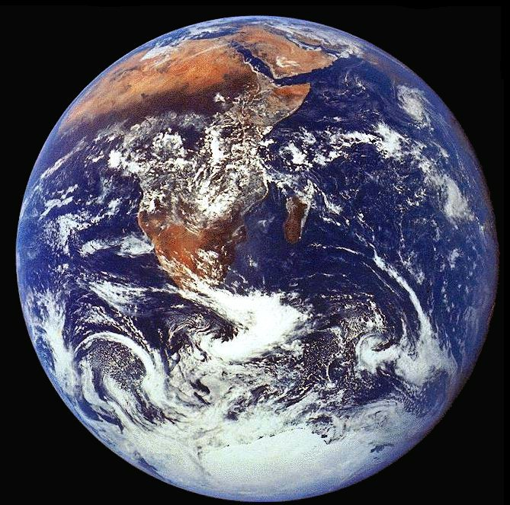
cc
Implementation of the IMP
Izolda Bulvinaite, European Commission ,DG MARE, E1

Slide 2
Why an Integrated EU Maritime Policy ?
In its strategic objectives for 2005-2009 the Commission declared
”the particular need for an all-embracing maritime policy aimed a developing a thriving maritime economy, in an environmentally sustainable manner. Such a policy should be supported by excellence in marine scientific research, technology and innovation”

Slide 3

The Policy Idea
Competitiveness
Research
Jobs
Skills
Safety
Coordination
(applying IMP)
Observation and
data collection
Marine
resources
Spatial
planning
Environment

Slide 4
The Vision of the Blue Paper
A new approach to maritime governance
Sustainability and economic growth
MSFD – the environmental pillar of the IMP

Slide 5
Why do we need a maritime governance?
The oceans and seas are our shared responsibility
across sectors and across borders
Maritime governance calls for solidarity and cooperation
Similar approaches will enhance cooperation
Global trends point to integration as the model for the future

Slide 6
Maritime Governance
Governance for EU policy making
Promoting integrated approaches within
Member States
Stakeholder dialogue
Cooperating with international partners on
e.g. global climate change, marine protected areas, piracy, …

Slide 7
Organisation at EU level
Steering group of
Commissioners
Member
States
Friends of the Presidency
High-Level Focal Points Group
DG MARE
Member States’ Expert Group
Other services
dealing with
maritime policy
European Parliament
Coordination of Committees

Slide 8
Guidelines to Member States
Member States to chart their own course,
on the basis of some general principles
Need for national integrated maritime policies
Creation of internal coordination structures
Regions and local communities have a role to play
Active participation by stakeholders
More efficient links at regional sea basin level

Slide 9
Dialogue with stakeholders
European Maritime Day - 20 May
Venice Platform Platform of maritime stakeholder organisations
Industry: Maritime Industries Forum
European Network of Maritime Clusters
Environmental NGOs Seas at risk
Research International Council for the Exploration of the Seas (ICES)
European Science Foundation – Marine Board
Waterborne Technology Platform
Aberdeen Declaration
Regions Conference of Peripheral Maritime Regions (CPMR)
Alliance of Maritime Regional Interests in Europe (AMRIE)

Slide 10
Cross-cutting tools for further integration
Integration of maritime surveillance systems;
Maritime Spatial Planning;
Marine data and knowledge
(European marine observation data network).

Slide 11
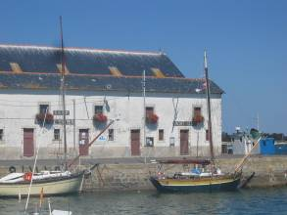
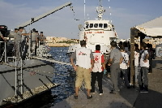
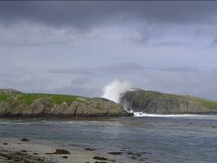
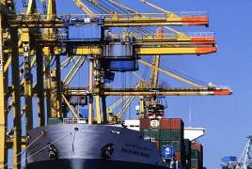

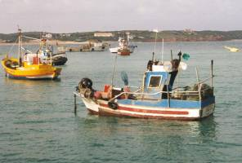
Seas are different – regional specificities
Geography
Political context
Economic situation
Social situation
Environmental challenges
Main objective
Adapting the IMP to regional challenges and opportunities for specific policy development
Providing added value in relation to capacities
Principle of Subsidiarity
Notes:
Maximising the sustainable use of the Seas
Building a knowledge and innovation base
Delivering the highest quality of life in coastal regions
Raising the visibility of Maritime Affairs

Slide 12
Integrated Maritime Policy in the Baltic Sea
Maritime actions form a substantial part of the EUSBSR
EUSBSR constitutes first steps towards regional implementation of the IMP
BSR – a model region
CBSS, BSPC, BSSSC – initiative to start up a WG on IMP

Slide 13
Key Maritime Actions of the EUSBSR
Maritime governance structures
Maritime Spatial Planning
Sustainable fisheries
Maritime surveillance
Clean shipping
Motorways of the Sea, Maritime Transport Space without Barriers
Pilot project for MSFD
Implementation of the HELCOM BSAP
Maritime clusters
Maritime training and education

Slide 14
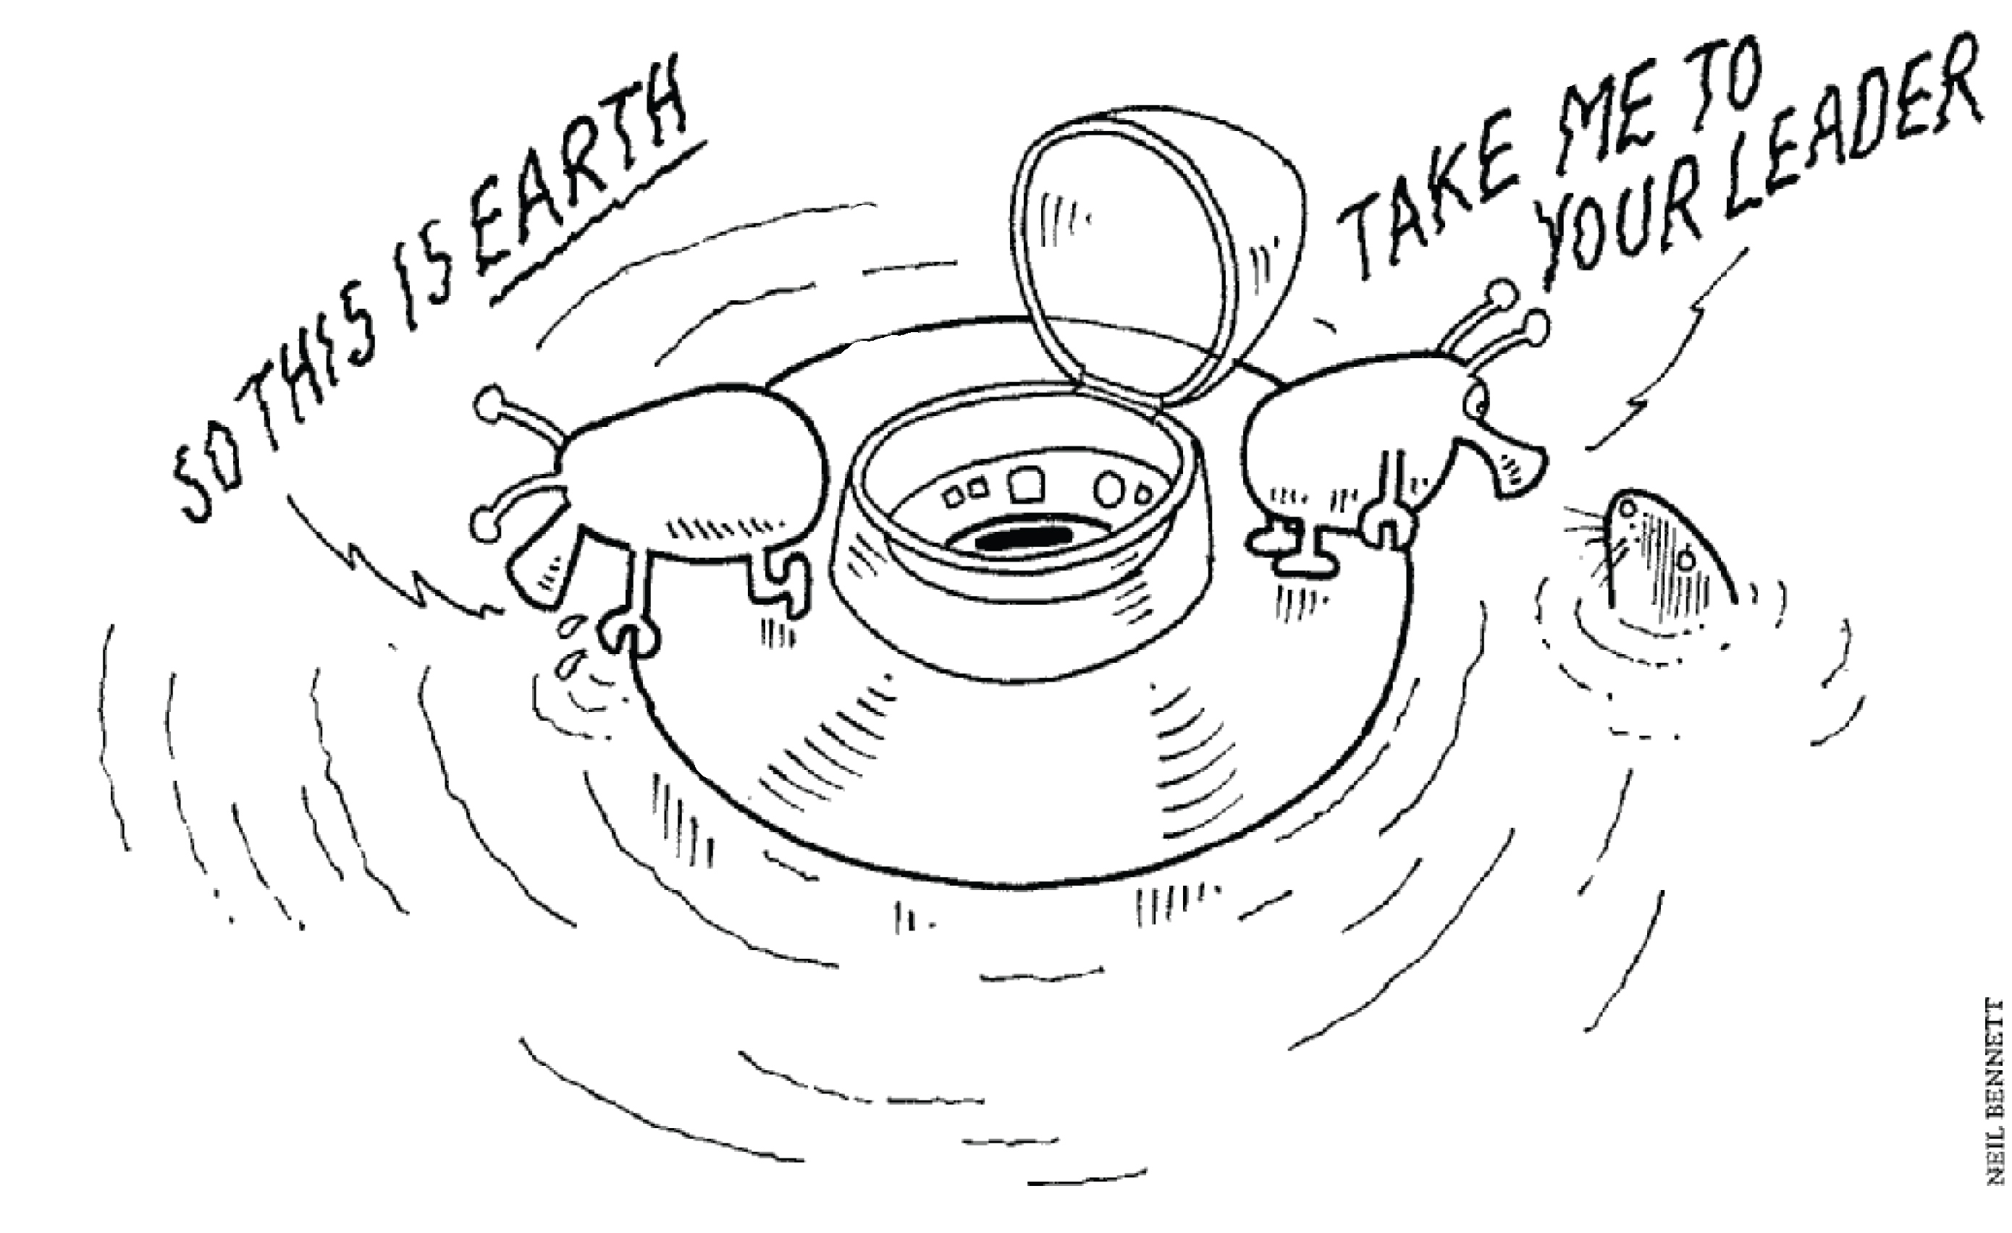

Slide 15
Thank you
for your attention!
http://ec.europa.eu/maritimeaffairs
http://ec.europa.eu/maritimeaffairs/spatial_planning_en.html

